Slide 1
Defense Against the Dark Arts (Abridged)
Thomas Rayner

Slide 2
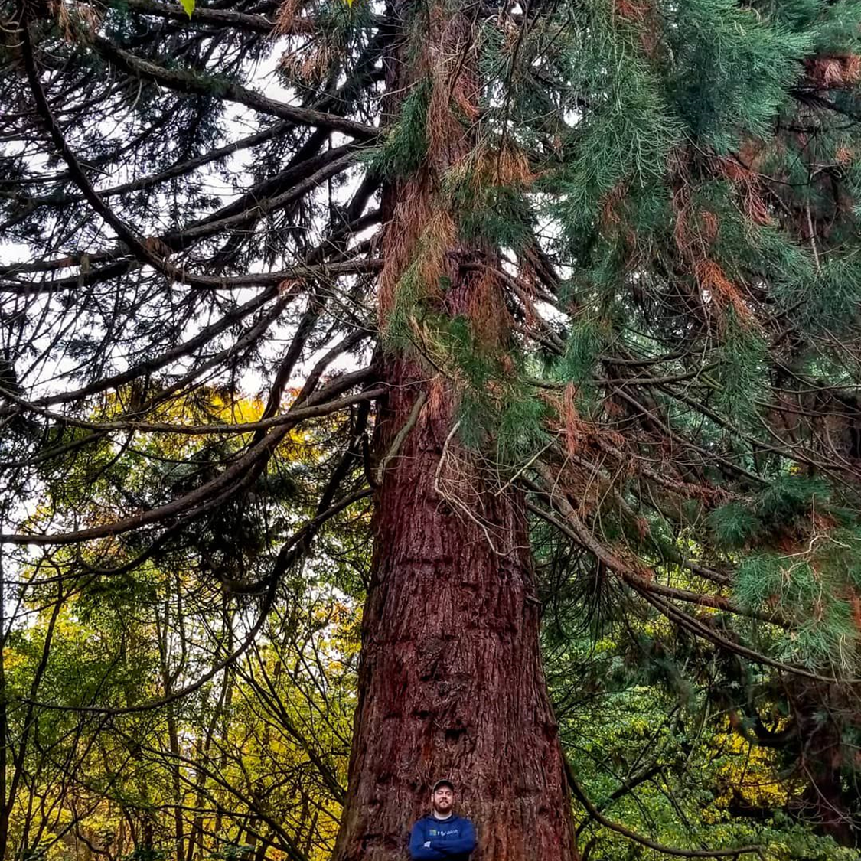
Thomas Rayner
Certified Information Systems Security Professional (CISSP)
Sr Security Service Engineer @ Microsoft
@MrThomasRayner

Slide 3


On Deck
Hacking’s past, present, future
How the bad guys make it hurt
Protecting your company
Protecting yourself

Slide 4

Hacking’s Past Present & Future
Hacking for fun and destruction
Break things for the sake of breaking things
Not organized at all
Advanced Persistent Threats
Nation-State backed attack groups
Highly organized
Hacking for profit
Steal things, holding things ransom
Somewhat organized
We’re about here

Slide 5

How the Bad Guys Make it Hurt
The CIA Triad
Confidentiality
Access to information
Privacy
Integrity
Information’s trustworthiness and accuracy
Availability
Reliable access to information by those who are authorized

Slide 6


Protecting Your Company

Slide 7

Protecting Your Company Why It Matters
Every company runs on information
Customer data
Employee data – people like getting paid
Proprietary information, trade secrets
Internal and external communications
It only takes one weak link in the chain

Slide 8

Protecting Your Company Backing Up (and Restoring) Data
If you’d miss it, back it up
All that data your company runs on
Backing up is only half the battle
Can you restore it?
Data retention
Off-site backups
Different data needs to be backed up differently

Slide 9

Protecting Your Company Encryption
Hiding and distorting information so it cannot be read
Encryption far pre-dates computers
Data at rest
On your computer, server, a USB drive
Data in transit
Email, IM, upload, download
Different data needs to be encrypted differently

Slide 10

Protecting Your Company Physical Security
Who has access?
How do they enjoy that access?
Exceptions, visitors, emergencies
Power, utilities
Disasters
Human, natural, water, fire
Human safety is always top priority

Slide 11

Protecting Your Company Social Engineering
Exploiting technology is hard
Exploiting humans is (comparatively) easy
Trust
Email, phone calls, IM, DM, spam, ads, any and every way of contacting a human
Urgency
Impersonation
Call to action
Expectations
Training makes a difference

Slide 12
Protecting Yourself

Slide 13
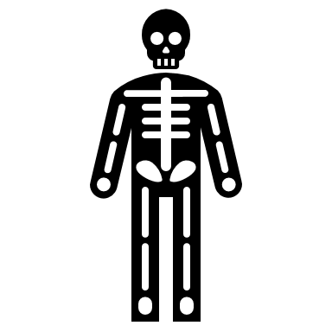
Protecting Yourself Why It Matters
“But I don’t have anything worth protecting” is denial
You have resources
If you lost your phone or computer for a day, what would happen? For a week? Forever?
You have access
Password re-use

Slide 14

Protecting Yourself Password Manager
Password re-use
A vault that holds your passwords and other credentials
Stop typing passwords
Better passwords
Backup and restore
Organization
Apps, plugins, etc. – passwords are everywhere you need them
LastPass, 1Password, Keepass

Slide 15

Protecting Yourself Multi-Factor Authentication
Passwords are a weak form of authentication
Types of authentication
Type 1: Something you know
Passwords, PIN, secret handshake
Type 2: Something you have
Phone, token, a specific device
Type 3: Something you are
Fingerprint, iris/retinal scan, facial geometry, gait, palm scan, ear print
Is a username a form of authentication?
Is having a password and a PIN MFA?
Microsoft Authenticator, Google Authenticator, SMS, Yubico keys

Slide 16
Wrapping Up
Protecting Your Company
Every company runs on data
Backup and restore data
Encrypt data at rest and in transit
Physical security can’t be neglected
People are part of your attack surface
Protecting Yourself
You have resources and access
Use a password manager
Multi-factor authentication

Slide 17
And for goodness sake, install updates and patches right away

Slide 18
Thank you!
Thomas Rayner
Certified Information Systems Security Professional (CISSP)
Sr Security Service Engineer @ Microsoft
@MrThomasRayner

